Slide 1
Intro and regressions
11
Probability
and
Statistics
COMS10011
Dr. Anne Roudaut
csxar@bristol.ac.uk
https://github.com/coms10011/2019_20

Slide 2
who am i?

Slide 3
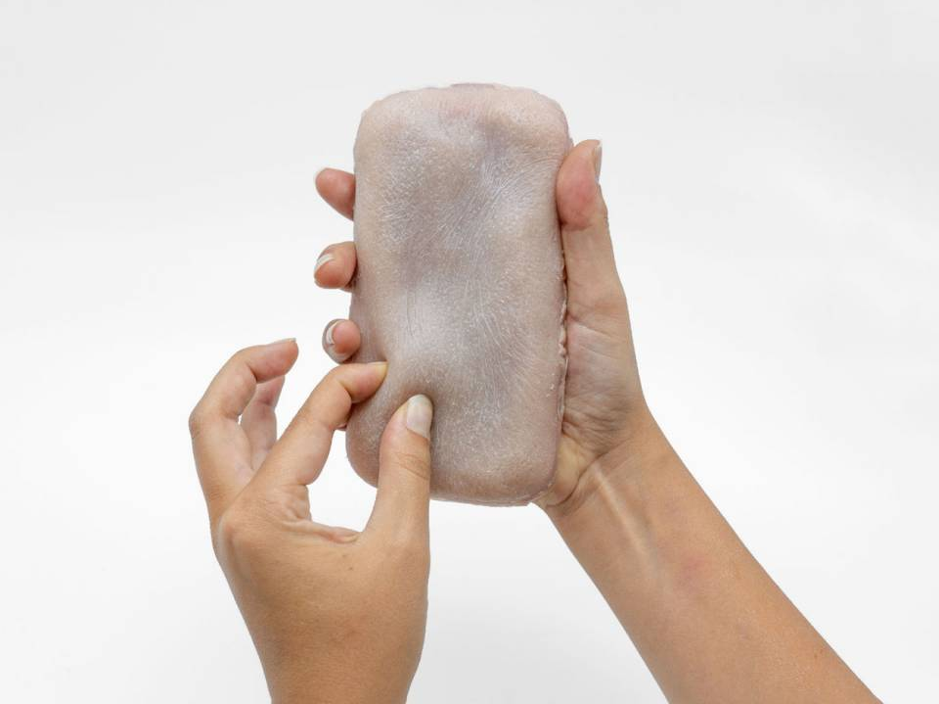
most resent work

Slide 4


Slide 5
Human Computer Interaction (HCI)::
a multidisciplinary field of study focusing on the design of computer technology and, in particular, the interaction between humans (the users) and computers

Slide 6
I
H
experimental
psychology
design
C
comp. science

Slide 7
experimental psychology::
the branch of psychology concerned with the scientific investigation of the responses of individuals to stimuli in controlled situations

Slide 8
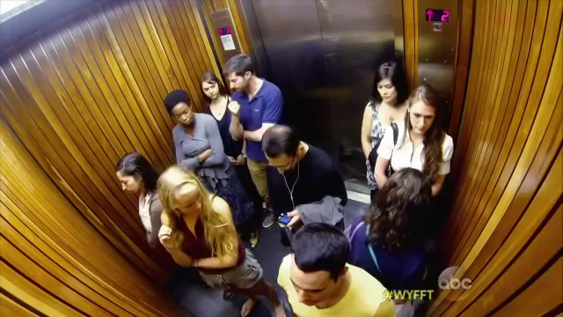
e.g. bandwagon effect (one of our many cognitive biases)

Slide 9


Slide 10

promised a 2nd marshmallow if resist to eat the 1st one until lady comes back (20mn)

Slide 11
what is the link with statistics?
like in many fields, statistics is the main tool to analyse, demonstrate, evaluate or predict

Slide 12
let’s start with an example

Slide 13
imagine you are designing a graphical interface for a new application on a laptop
how big should the buttons/icons be?

Slide 14
Fitts’law ::
the time required to acquire a target of size w at distance d can be described as T = a + b log (1 + d/w)

Slide 15

smaller bin = harder and further = harder

Slide 16
Fitts’law ::
the time required to acquire a target of size w at distance d can be described as T = a + b log (1 + d/w)
T = a + b IndexDifficulty
(depends on input device)

Slide 17
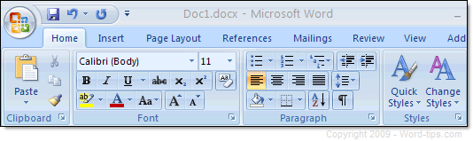
Word 2000
Word today
e.g. reason why we have ribbons in Word now

Slide 18
Fitts’law :: T = a + b ID
time required to acquire a target
but where does this equation come from?

Slide 19
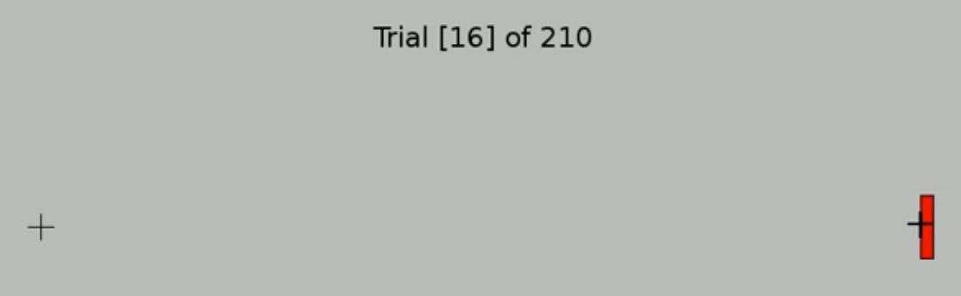
let’s run an experiment and ask one participant to click on targets of different IDs

Slide 20
T time
(ms)
ID index of difficulty

Slide 21
T time
(ms)
y = a + b x
Fitts! T = a + b ID
ID index of difficulty
this a regression line

Slide 22
regression ::
a technique for determining the statistical relationship between two or more variables where a change in a dependent variable is associated with, and depends on, a change in one or more independent variables
arguably the most basic technique for machine learning

Slide 23
quick terminology of regressions

Slide 24
T time
(ms)
ˆ
y = a + b x
ID index of difficulty

Slide 25
T time
(ms)
ˆ
y = a + b x
independent variable
ID index of difficulty

Slide 26
T time
(ms)
ˆ
y = a + b x
dependent variable
independent variable
ID index of difficulty

Slide 27
T time
(ms)
ˆ
y = a + b x
a is the y intercept
ID index of difficulty

Slide 28
T time
(ms)
b is the slope
ˆ
y = a + b x
a is the y intercept
ID index of difficulty

Slide 29
T time
(ms)
residual (deviation)
b is the slope
ˆ
y = a + b x
a is the y intercept
ID index of difficulty

Slide 30
goodness of fit

Slide 31
T time
(ms)
T = 2.3 + 1.1 ID
ID index of difficulty
how can you be sure this line is a good fit to our data?

Slide 32
T time
(ms)
T = 2.3 + 1.1 ID
ID index of difficulty
how can you be sure this line is a good fit to our data? what about now?
<brainstorming with your neighbor>

Slide 33
we can compute the goodness of fit with several methods
e.g. standard error of the estimate
or R squared

Slide 34
1
standard error of the estimate
T time
(ms)
Fitts! T = 2.3 + 1.1 ID
∑ ( )²
(sample size-2)
ID index of difficulty

Slide 35
1
standard error of the estimate
T time
(ms)
Fitts! T = 2.3 + 1.1 ID
ˆ
∑ (estimated y – actual y)²
(sample size-2)
ID index of difficulty
also called degree of freedom

Slide 36
S gives a standard error in the metric of the data (the less the better)

Slide 37
2
R squared
T time
(ms)
mean
Fitts! T = 2.3 + 1.1 ID
∑ ( )²
ID index of difficulty
∑ ( )²

Slide 38
2
R squared
T time
(ms)
mean
Fitts! T = 2.3 + 1.1 ID
this formula works if your line is computed by the least square regression method (the one used by R)
ˆ
∑ ( estimated y – mean y )²
ID index of difficulty
∑ ( actual y – mean y )²

Slide 39
2
R squared
T time
(ms)
mean
Fitts! T = 2.3 + 1.1 ID
ˆ
you could also find it
in a this format which
is more genetic
∑ (actual y – estimated y )²
1 -
∑ ( actual y – mean y )²

Slide 40
R squared
T time
(ms)
mean
Fitts! T = 2.3 + 1.1 ID
ˆ
you could also find it
in a this format which
is more genetic
∑ (actual y – estimated y )²
1 -
∑ ( actual y – mean y )²

Slide 41
R² gives a percentage and 100% means perfect fit (>70% is better)

Slide 42
T time
(ms)
T = 2.3 + 1.1 ID
R² = 0.97
ID index of difficulty

Slide 43
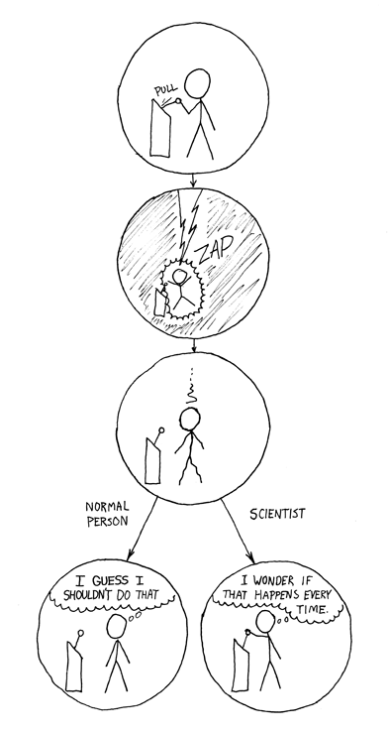
to gain additional confidence we repeat
we gain trust in a model if it fits the data with little error when
it is verified with a lot of data
it holds across very different people
it is verified in independent studies…

Slide 44
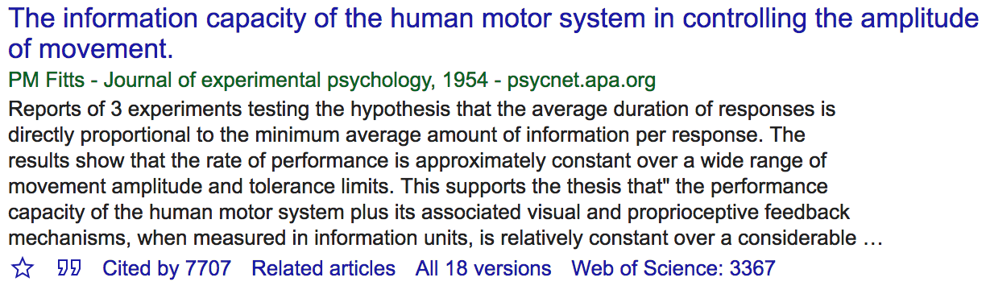
Fitts’s paper probably most cited in HCI, studies done and redone many times
Notes:
28 + brainstorming

Slide 45
practically

Slide 46
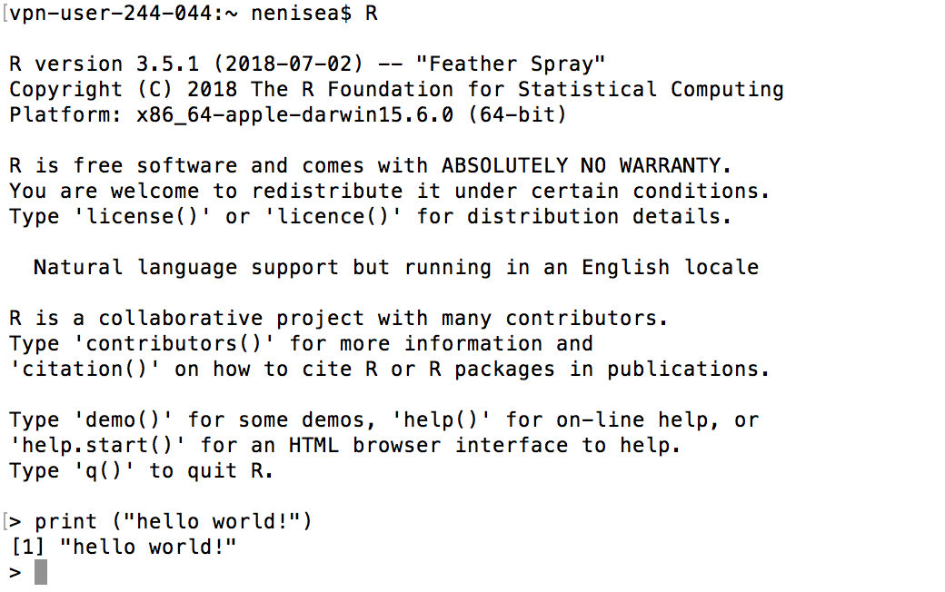
R
Install at
https://www.r-project.org/
we will be using R and I will try to give you as much as possible of examples
Notes:
Open terminal
R
Print(“hello world!”)

Slide 47
R
in your terminal
head(cars) # cars is a table that already comes with R and contain 50 observations of speed and distance in two rows
scatter.smooth(x=cars$speed, y=cars$dist, main="Dist ~ Speed")
linearMod <- lm(dist ~ speed, data=cars) # build linear regression model
abline(linearMod, col="blue") # draw the regression line
summary(linearMod) # goodness of fit
Notes:
head(cars) # cars is a table that already comes with R and contain 50 observations of speed and distance in two rows
scatter.smooth(x=cars$speed, y=cars$dist, main="Dist ~ Speed") # scatterplot
linearMod <- lm(dist ~ speed, data=cars) # build linear regression model on full data
summary(linearMod) # summary(linearMod)$r.squared
abline(linearMod, col="blue")

Slide 48
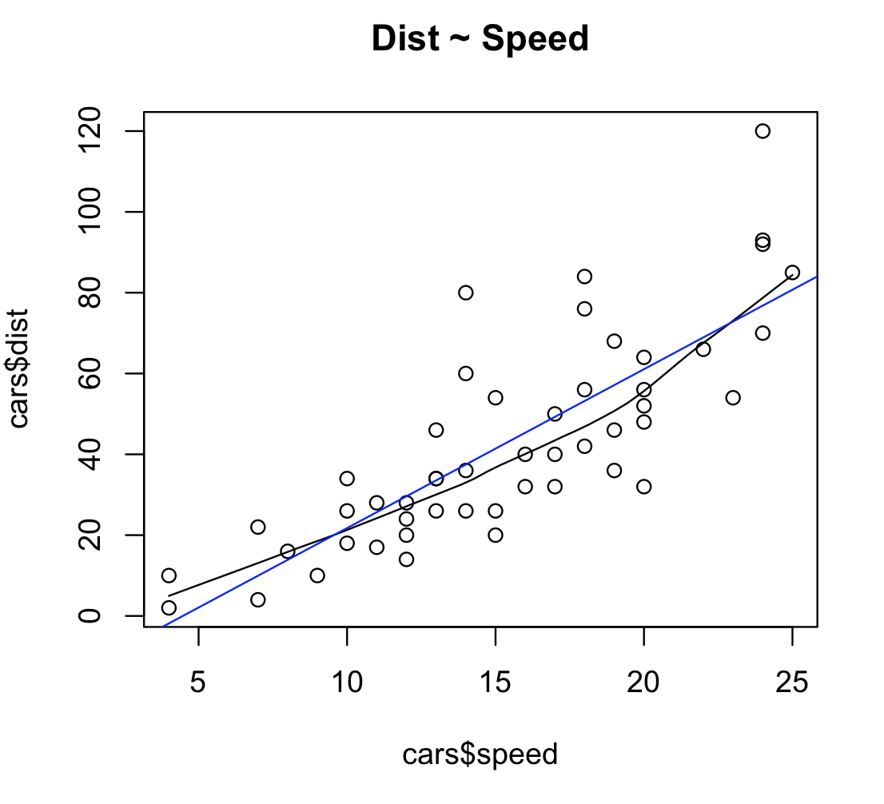
R

Slide 49
R
Call:
lm(formula = dist ~ speed, data = cars)
Residuals:
Min 1Q Median 3Q Max
-29.069 -9.525 -2.272 9.215 43.201
Coefficients:
Estimate Std. Error t value Pr(>|t|)
(Intercept) -17.5791 6.7584 -2.601 0.0123 *
speed 3.9324 0.4155 9.464 1.49e-12 ***
---
Signif. codes: 0 ‘***’ 0.001 ‘**’ 0.01 ‘*’ 0.05 ‘.’ 0.1 ‘ ’ 1
Residual standard error: 15.38 on 48 degrees of freedom
Multiple R-squared: 0.6511, Adjusted R-squared: 0.6438
F-statistic: 89.57 on 1 and 48 DF, p-value: 1.49e-12
dist = -17.5791 + 3.9324 * speed

Slide 50
R
Call:
lm(formula = dist ~ speed, data = cars)
Residuals:
Min 1Q Median 3Q Max
-29.069 -9.525 -2.272 9.215 43.201
Coefficients:
Estimate Std. Error t value Pr(>|t|)
(Intercept) -17.5791 6.7584 -2.601 0.0123 *
speed 3.9324 0.4155 9.464 1.49e-12 ***
---
Signif. codes: 0 ‘***’ 0.001 ‘**’ 0.01 ‘*’ 0.05 ‘.’ 0.1 ‘ ’ 1
Residual standard error: 15.38 on 48 degrees of freedom
Multiple R-squared: 0.6511, Adjusted R-squared: 0.6438
F-statistic: 89.57 on 1 and 48 DF, p-value: 1.49e-12
also note this
pvalue<0.01
pvalue <0
(will explain next week)

Slide 51
usages of regressions

Slide 52

predicting ebay's online auction prices using functional data analysis

Slide 53
predicting the number of passerby who will pass in front of a public display and use the data for choosing advertisement prices

Slide 54
predicting the number of claim in a given time period (used by insurance companies)

Slide 55
understand the impact of a machine (on a production line) on the quality of the products created

Slide 56
understand the relationship between wait times of callers and number of complaints in a call centre

Slide 57

retail store wants to extend shopping hours to increase sales, but regression indicates that increase in revenue not sufficient to support rise in operating expenses

Slide 58
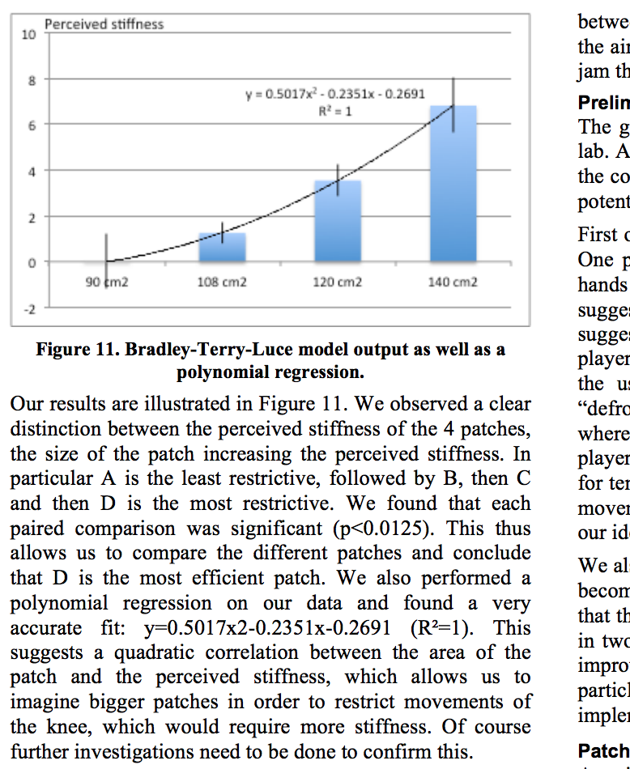
you can also fit a curve =
polynomial fitting

Slide 59
R
polynomial regression model
Mod2 <- lm(dist~poly(speed,2,raw=TRUE), data=cars)
Mod3 <- lm(dist~poly(speed,3,raw=TRUE), data=cars)
Mod4 <- lm(dist~poly(speed,4,raw=TRUE), data=cars)
Notes:
11

Slide 60
summary

Slide 61
continuous independent variable
What type of data?
continuous dependent variable
regressions

Slide 62
continuous independent variable
What type of data?
continuous dependent variable
discrete dependent variable
Logistic
regressions
won’t look
at it
regressions

Slide 63
continuous independent variable
What type of data?
discrete independent variable
continuous dependent variable
discrete dependent variable
Continuous dependent variable
Discrete/categorical dependent variable
regressions
Logistic
regressions
normally distributed
skewed
2 grp
>2 grp
2 grp
>2 grp
2 grp
>2 grp
Non paired
paired
Non paired
paired
Non paired
paired
Non paired
paired
Counts >= 5 in >= 75% cells
Counts >= 5 in < 75% cells
T-test
ANOVA
Mann-Whitney Utest
Wilcoxon signed rank test
Kruskall-Wallis test
Chi-square test
Fisher’s exact test
Chi-square test
Paired-t-test
Friiedman test
McNemar’s test

Slide 64
continuous independent variable
What type of data?
discrete independent variable
continuous dependent variable
discrete dependent variable
Continuous dependent variable
Discrete/categorical dependent variable
regressions
Logistic
regressions
normally distributed
skewed
2 grp
>2 grp
by the end of this unit you will know what statistics tests to perform depending on your data and how
2 grp
>2 grp
2 grp
>2 grp
Non paired
paired
Non paired
paired
Non paired
paired
Non paired
paired
Counts >= 5 in >= 75% cells
Counts >= 5 in < 75% cells
T-test
ANOVA
Mann-Whitney Utest
Wilcoxon signed rank test
Kruskall-Wallis test
Chi-square test
Fisher’s exact test
Chi-square test
Paired-t-test
Friiedman test
McNemar’s test

Slide 65
continuous independent variable
What type of data?
discrete independent variable
continuous dependent variable
discrete dependent variable
Continuous dependent variable
Discrete/categorical dependent variable
regressions
Logistic
regressions
normally distributed
skewed
2 grp
>2 grp
2 grp
>2 grp
2 grp
>2 grp
Non paired
paired
Non paired
paired
Non paired
paired
Non paired
paired
Counts >= 5 in >= 75% cells
Counts >= 5 in < 75% cells
T-test
ANOVA
Mann-Whitney Utest
Wilcoxon signed rank test
Kruskall-Wallis test
Chi-square test
Fisher’s exact test
Chi-square test
Paired-t-test
Friiedman test
McNemar’s test

Slide 66
unit menu
Linear regression
Hypothesis testing, comparing things
Experimental design part 1
Experimental design part 2
T-test and ANOVA
Pre-requisite to ANOVA
Non-parametric tests
Categorical data: Chi-square
Sample size, power and effect size
P-hacking and alternatives tests

Slide 67
resources

Slide 68
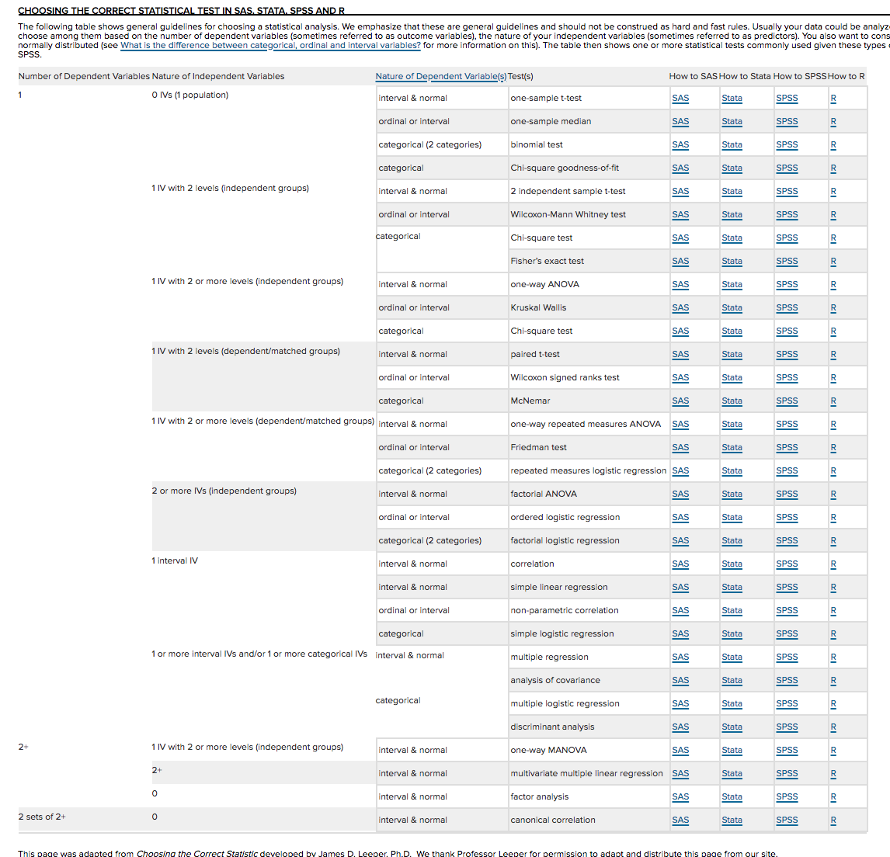
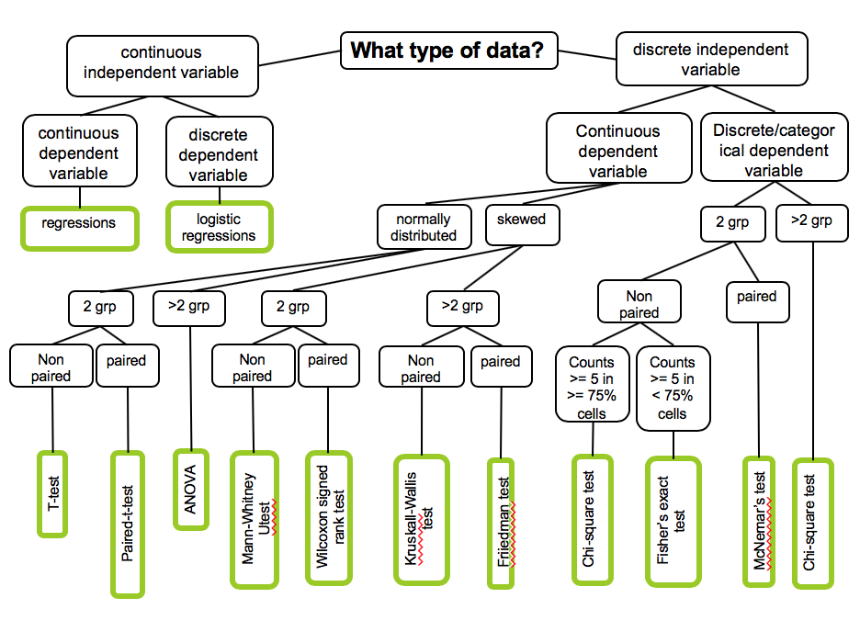
https://stats.idre.ucla.edu/other/mult-pkg/whatstat/

Slide 69
the text book I am using and a suggestion of YouTube video channel

Slide 70
videos on regressions
https://www.youtube.com/watch?v=WWqE7YHR4Jc
https://www.youtube.com/playlist?list=PLF596A4043DBEAE9C

Slide 71
take away
Explain what is a linear regression
Give the terminology of a regression line
Give the two formulas of goodness of fit
Be able to compute the two formulas given a few observations

Slide 72
end

